Slide 1
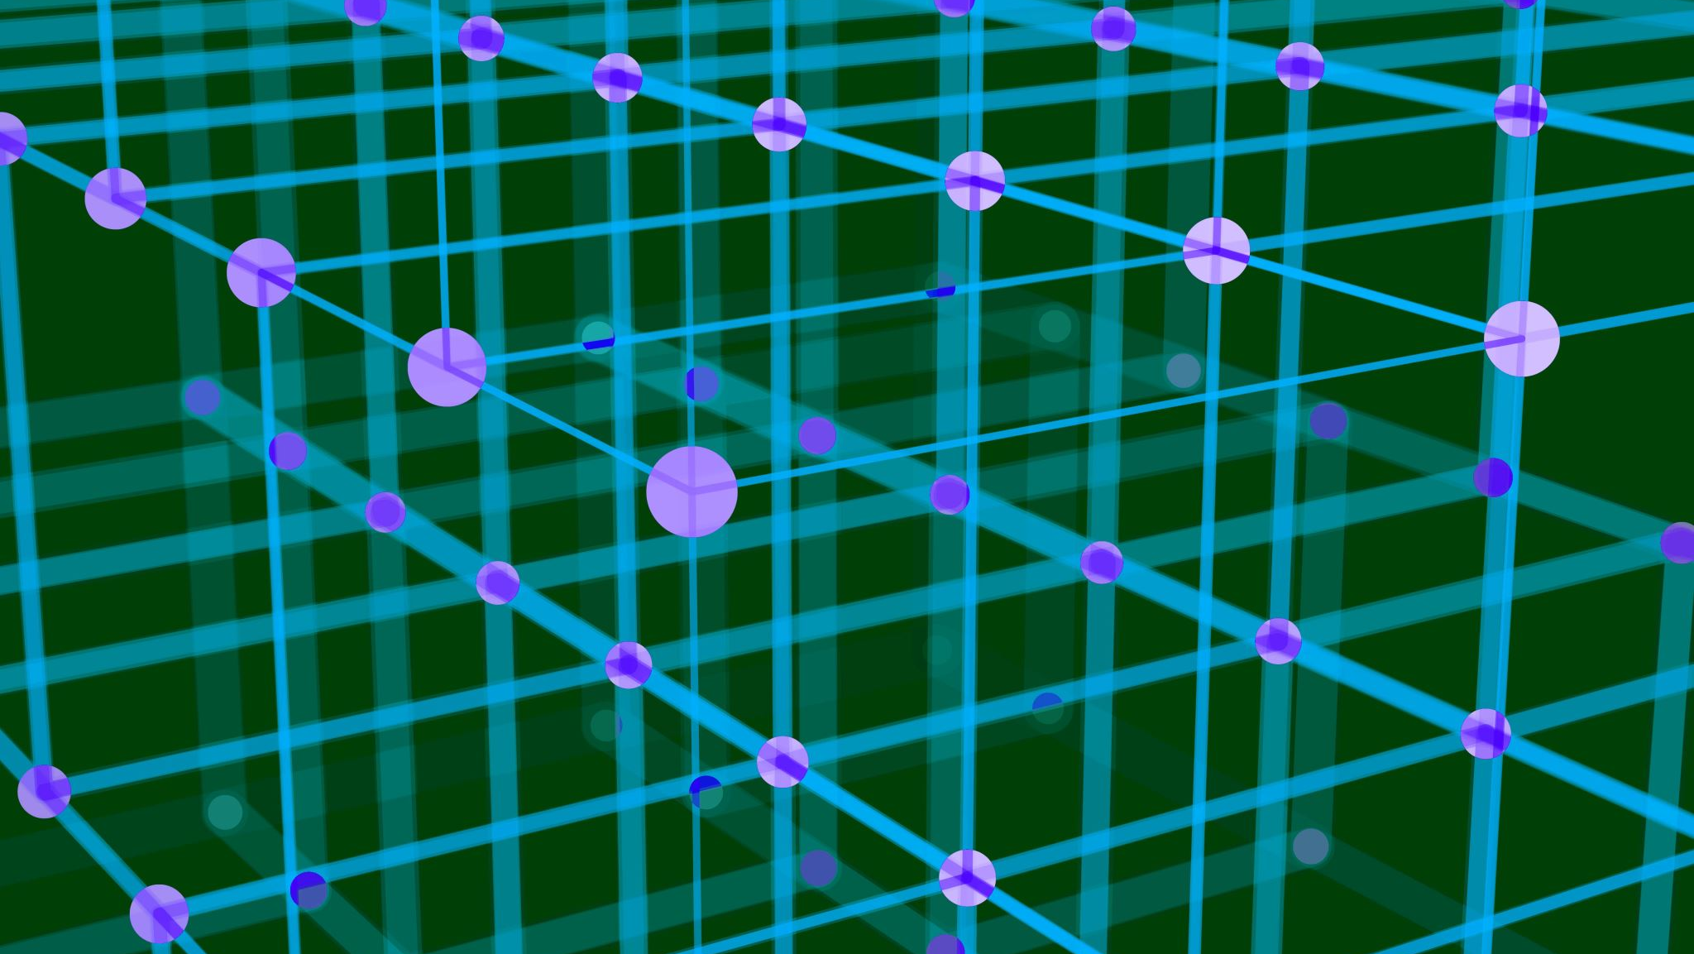
Z-transform and Their inverse
By:
Sudhan kandel (2/077)
Pradyuman bhattarai (/077)

Slide 2
Table of Content
Introduction
Formula
Application
Example
Discrete vs continuous

Slide 3
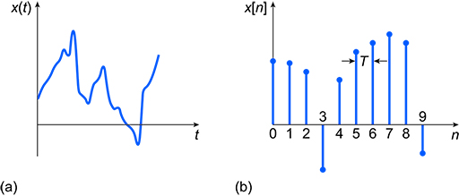
Continuous vs Discrete
Continous | Discrete
Time is continous | Time is Discrete
Continous signal can be define for all value of time | Discrete signal can be define for only at discrete time.
Here independent varaibale is time and is denoted with t. | Here independent variable is time and is denoted with n.

Slide 4
Introduction
It simlpy converts time domain signal to frequency domain signal
Analysis of continuous time LTI systems can be done using z-transforms. It is a powerful mathematical tool to convert differential equations into algebraic equations.

Slide 5
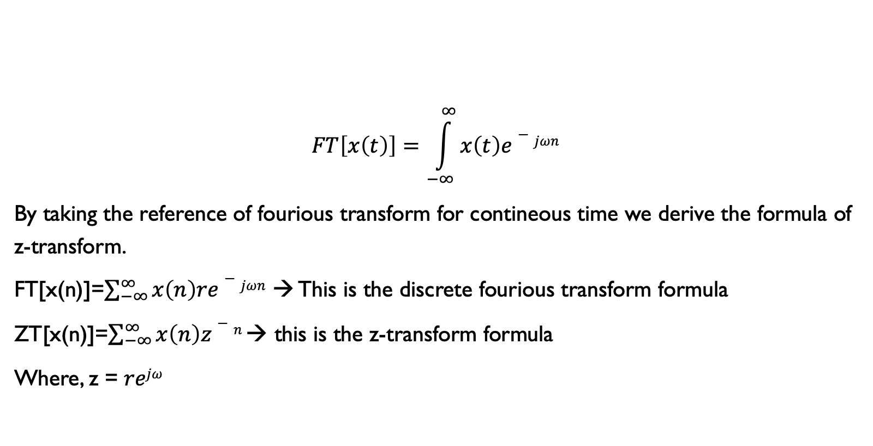
Formula of Z-Transform
$$FT\left[x\left(t\right)\right]=\int_{−∞}^{∞}{x\left(t\right)e−jωn}$$
By taking the reference of fourious transform for contineous time we derive the formula of z-transform.
FT[x(n)]=$\sum_{−∞}^{∞}{x\left(n\right)re−jωn}$ → This is the discrete fourious transform formula
ZT[x(n)]=$\sum_{−∞}^{∞}{x\left(n\right)z−n }$→ this is the z-transform formula
Where, z = $rejω$

Slide 6
Example
A finite sequence x(n) is defined as x(n)={5,3,-3,0,4} find x(z).
Sol^{n},
Let us consider x(0)=5 then,
x(1) →3
x(2) →-3
x(3) →0
x(4) → 4

Slide 7
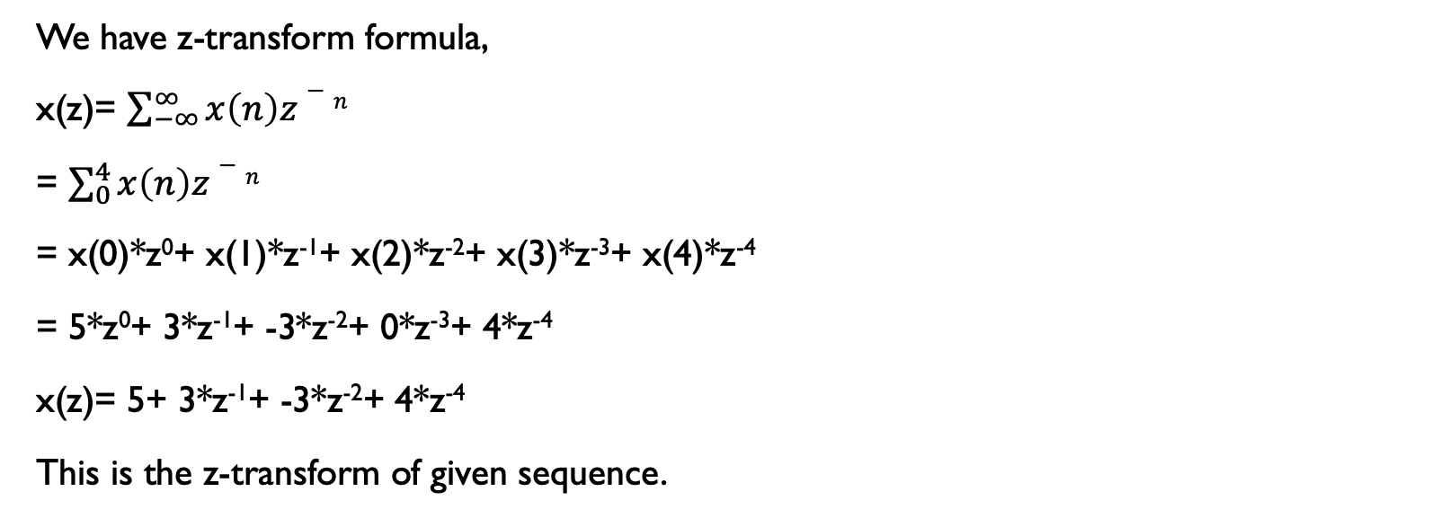
Example
We have z-transform formula,
x(z)= $\sum_{−∞}^{∞}{x\left(n\right)z−n }$
= $\sum_{0}^{4}{x\left(n\right)z−n }$
= x(0)*z⁰+ x(1)*z⁻¹+ x(2)*z⁻²+ x(3)*z⁻³+ x(4)*z⁻⁴
= 5*z⁰+ 3*z⁻¹+ -3*z⁻²+ 0*z⁻³+ 4*z⁻⁴
x(z)= 5+ 3*z⁻¹+ -3*z⁻²+ 4*z⁻⁴
This is the z-transform of given sequence.

Slide 8
Application of Z-transform
Used to analysis digital filter.
Calculate of signal to control system
Voice transmission.
For automatic control in telecommunication.

Slide 9

Inverse Z Transform
We know, z-transform is given by,
Z(Un) =$\sum_{−∞}^{∞}{x\left(n\right)z−n }$
Inverse of this can be written as,
Z⁻¹(U(z))=Un

Slide 10

Example
Find inverse z-transform of z/z-a where ROC is 1. |z| > |a| 2. |z| < |a|
Soln,
Let, u(z)=$\frac{z}{a}$-a
1. For, |z| > |a|
$\frac{|a|}{|z|}$<1
Taking z common,
U(z)=$\frac{z}{z(1−\frac{a}{z})}$

Slide 11


Example
Or, u(z)= (1- $\frac{a}{z}$)⁻¹
= 1+ $\frac{a}{z}$+ ($\frac{a}{z} )$²⁺ ….. +($\frac{a}{z})$^{n}+…..
= $\sum_{n=0}^{∞}{\text{(}\frac{a}{z}\text{)}\text{n} }$
= $\sum_{n=0}^{∞}{\text{a}^nz^n}$
Z⁻¹($ζ$(z))=a^{n}
n>1

Slide 12

example
2. |z| < |a|
$\frac{|z|}{|a|}$<1
U(z)=$\frac{z}{z−a}$
=$−\frac{−1}{a}(\frac{z}{1−\frac{z}{a})})$
=$−\frac{z}{a}\left(a−\frac{z}{a}\right)$⁻¹
=-$\frac{z}{a}$(1+ $\frac{z}{a}$+($\frac{z}{a}$)² +……+($\frac{z^n}{a^n}$)+….. $∞$
=- $\frac{z}{a}$-($\frac{z}{a}$)² -($\frac{z}{a}$)³ -………-$∞$

Slide 13
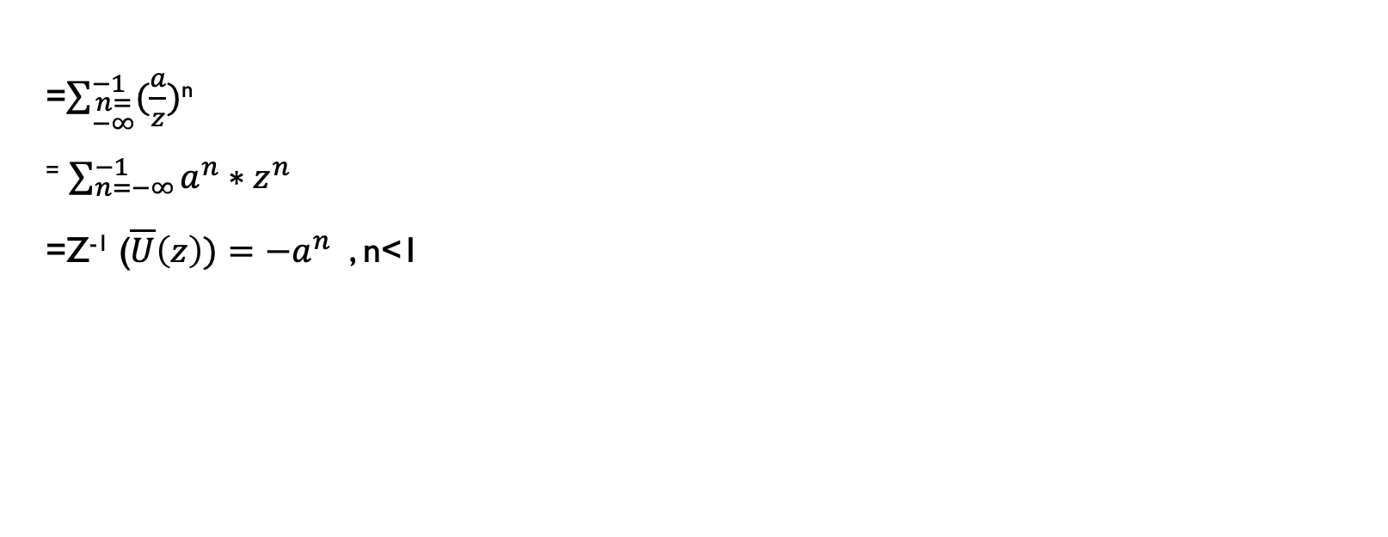
Example
=$\sum_{\begin{aligned}n= \\ −∞\end{aligned}}^{−1}{(\frac{a}{z})}$^{n}
⁼ $\sum_{n=−∞}^{−1}{a^{n}∗z^{n}}$
=Z⁻¹ ($\overline{U}\left(z\right))=−a^{n}$ , n<1

Slide 14

Thank You

